Slide 1
Filling the Gap
With Ellen Mndima

Slide 2
The gap
Gap – the space between your business idea and your proposal to an investor
What happens in the Gap?
Expected to have something to show your potential investor that they can believe in and write you a fat beautiful cheque
What does this involve?
A team – diversify
A plan – know where you want to go
A prototype – proof of concept
Others – Sacrifice (esp. TIME), Discipline (self management) and Coffee (I discourage energy drinks!)

Slide 3
The Effective Team
They communicate well and often
They focus on goals and results
Everyone contributes their fair share
They offer each other support
Team members are diverse
Good leadership
They are organised
They have fun

Slide 4
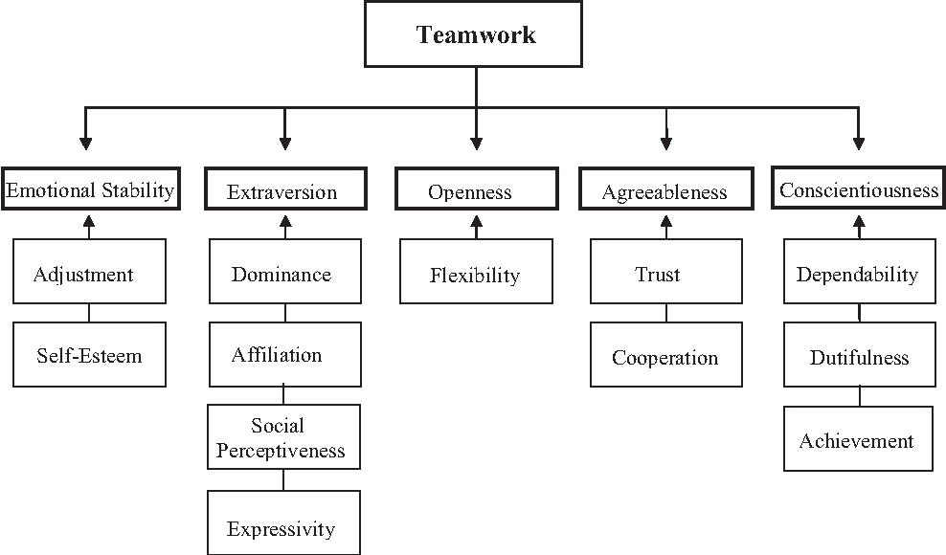
Teamwork Requirements

Slide 5
The Plan
Business Plan – allows you to put on paper where you want to be over a certain period of time, and helps you visualise the strategy to get there.
Includes:
Executive Summary
Mission, vision, goals and objectives, keys to success
Company Summary: Background, resources, Marketing method, management, ownership structure, internal analysis
Products/services
Market assessment: external analysis, customers, strategic alternatives
Strategic implementation
Financial Plan: Projections, Contingency

Slide 6
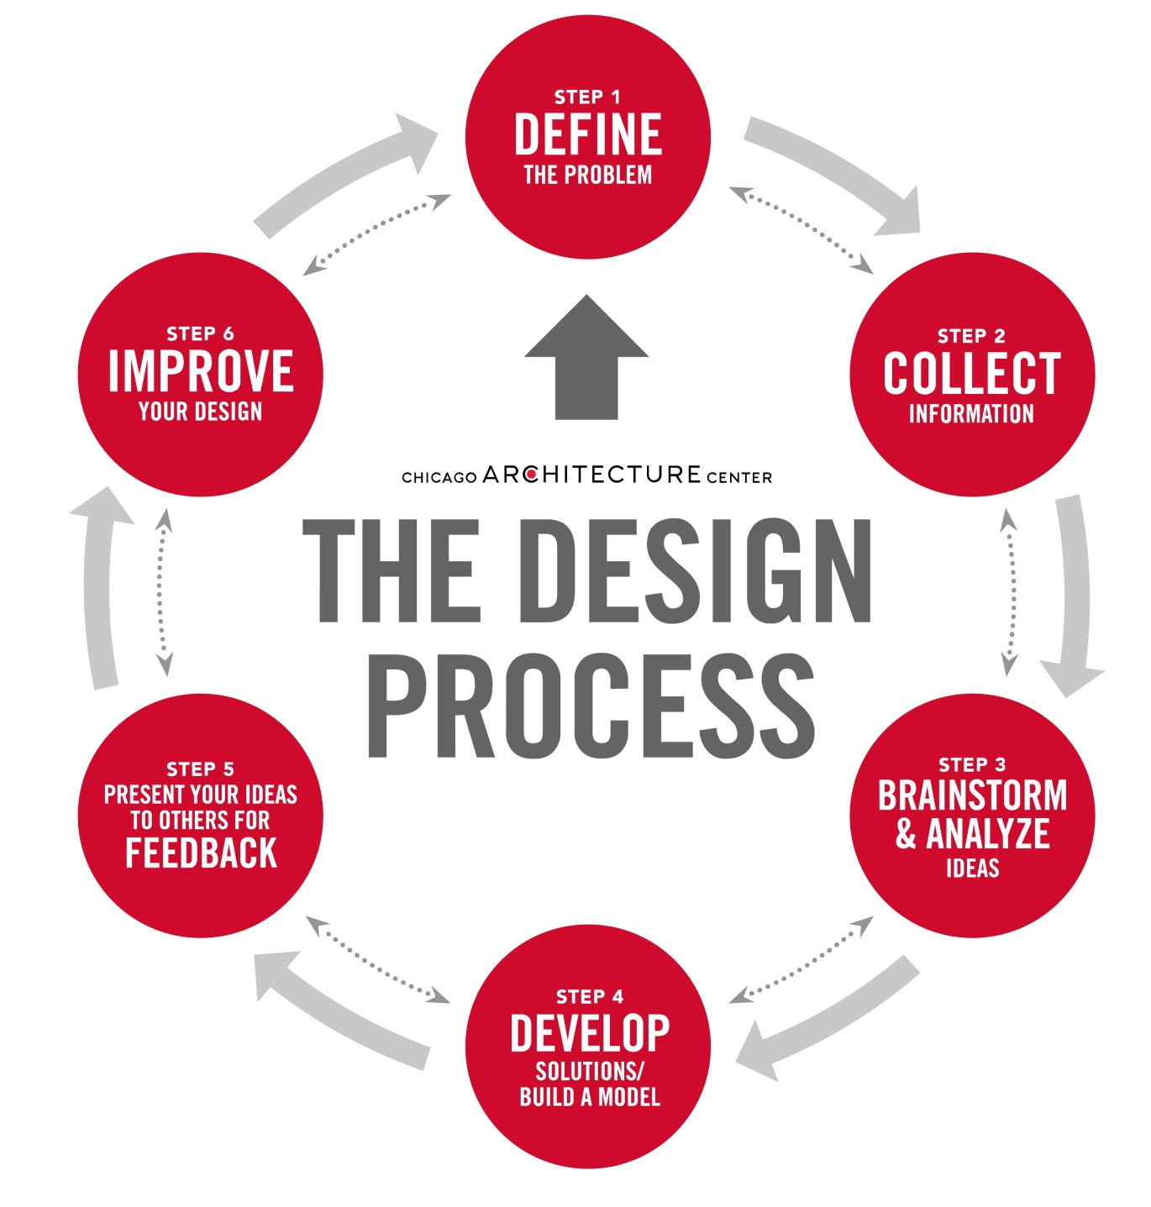
The Prototype – design process
Notes:
Define the Problem - You can’t find a solution until you have a clear idea of what the problem is.
Collect Information - Collect sketches, take photographs and gather data to start giving you inspiration.
Brainstorm and Analyze Ideas - Begin to sketch, make, and study so you can start to understand how all the data and information you’ve collected may impact your design.
Develop Solutions - Take your preliminary ideas and form multiple small-scale design solutions.
Gather Feedback - Present your ideas to as many people as possible: friends, teachers, professionals, and any others you trust to give insightful comments.
Improve - Reflect on all of your feedback and decide if or to what extent it should be incorporated. It is often helpful to take solutions back through the Design Process to refine and clarify them.

Slide 7
How to Market your App – for free!
Get in touch before you bring it to the market
Reach out to influencers
Leverage your mobile website
Feature your app in an official blog
Feature your app in your emails
Create a demo video
Consider alternative app stores
Apply for awards
Search Engine Optimisation
Don’t rely on App Stores alone – google can help
Integrate Social Share within the app
Roll out new updates constantly

Slide 8
How to Market your App – for free!
Join developers and entrepreneurs groups in social media
Create an eye catch app icon
Take great screenshots of your app live
App Store Optimisation
Build a great app landing page
Include app download links on your website
Get featured on mobile app review sites
Be prepared for press
Promote through a promo video
Use your social network

Slide 9
How to Market your App – for free!
Write an announcement blog
Have a link to your app in you email signature
Promote your app In-Store (QR codes, etc)
Join LinkedIn and Facebook Groups
Recruit customers locally
Blog commenting
Influencer sharing – joint ventures
Do the unexpected
Post on Pinterest
Run a contest
Sincerely respond to all your reviews

